Slide 1
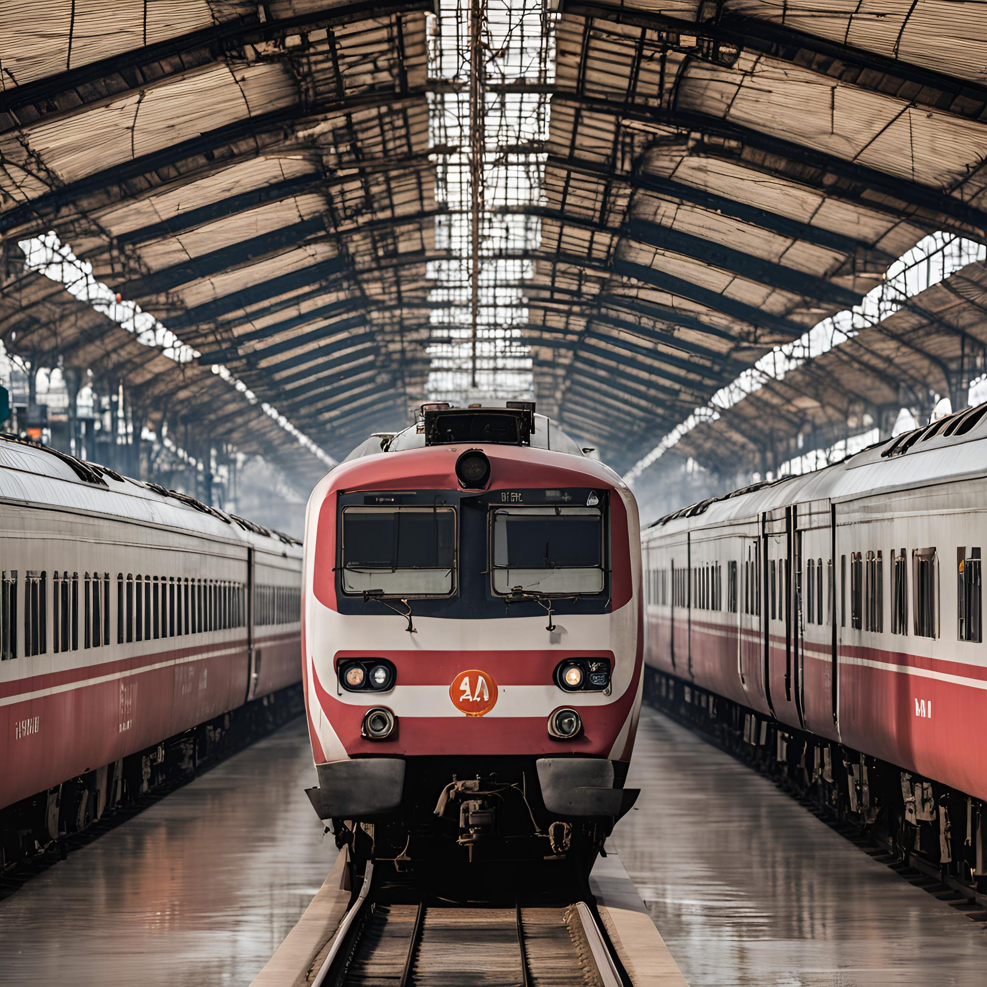
RAILVISION INTELLIGENCE
MEMBERS:
MD MOZAMMIL ASHRAF
V THARUN
KHAROSEKAR VARADRAJ A
VEDANT RANSINGH
KHAN SAMIM MASUD
SUBMITTED TO :
DR. SANTOSH KUMAR

Slide 2
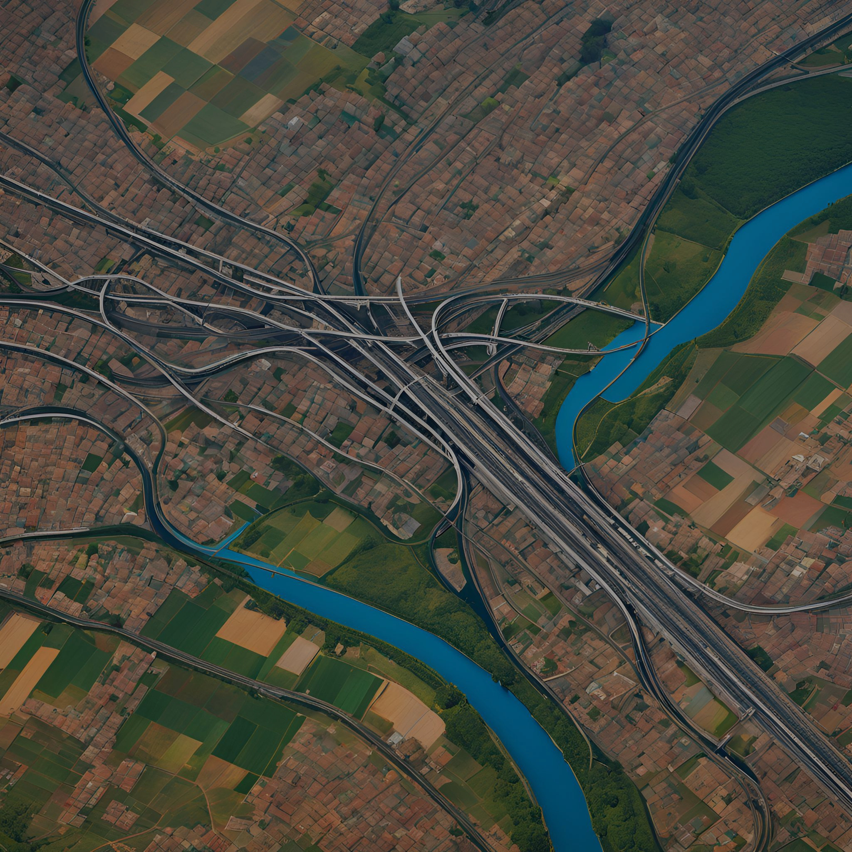
INTRODUCTION
The railway sector plays a crucial role in economic growth and social service delivery, yet it faces significant challenges in monitoring and maintenance due to vast coverage areas, aging infrastructure, and external factors such as natural disasters. Traditional methods like manual inspections and ground-based sensors are often time-consuming, costly, and limited in scope. To address these issues, the integration of satellite imagery and artificial intelligence (AI) presents a transformative solution. Satellite imagery offers comprehensive coverage, high-resolution detail, and enables fully automated analysis to detect anomalies, assess risks, and identify maintenance needs. This innovative approach enhances safety, operational efficiency, and cost-effectiveness, while laying the foundation for a data-driven, modernized railway management system. In the face of increasing transportation demands and climate-related challenges, this project aims to optimize railway monitoring and maintenance through advanced AI-powered satellite imagery analysis.
Traditional methods relied on manual tracking and basic sensors.
Transition to GPS-based systems improved real-time tracking.
Satellite imagery and AI now revolutionizing the industry.

Slide 3
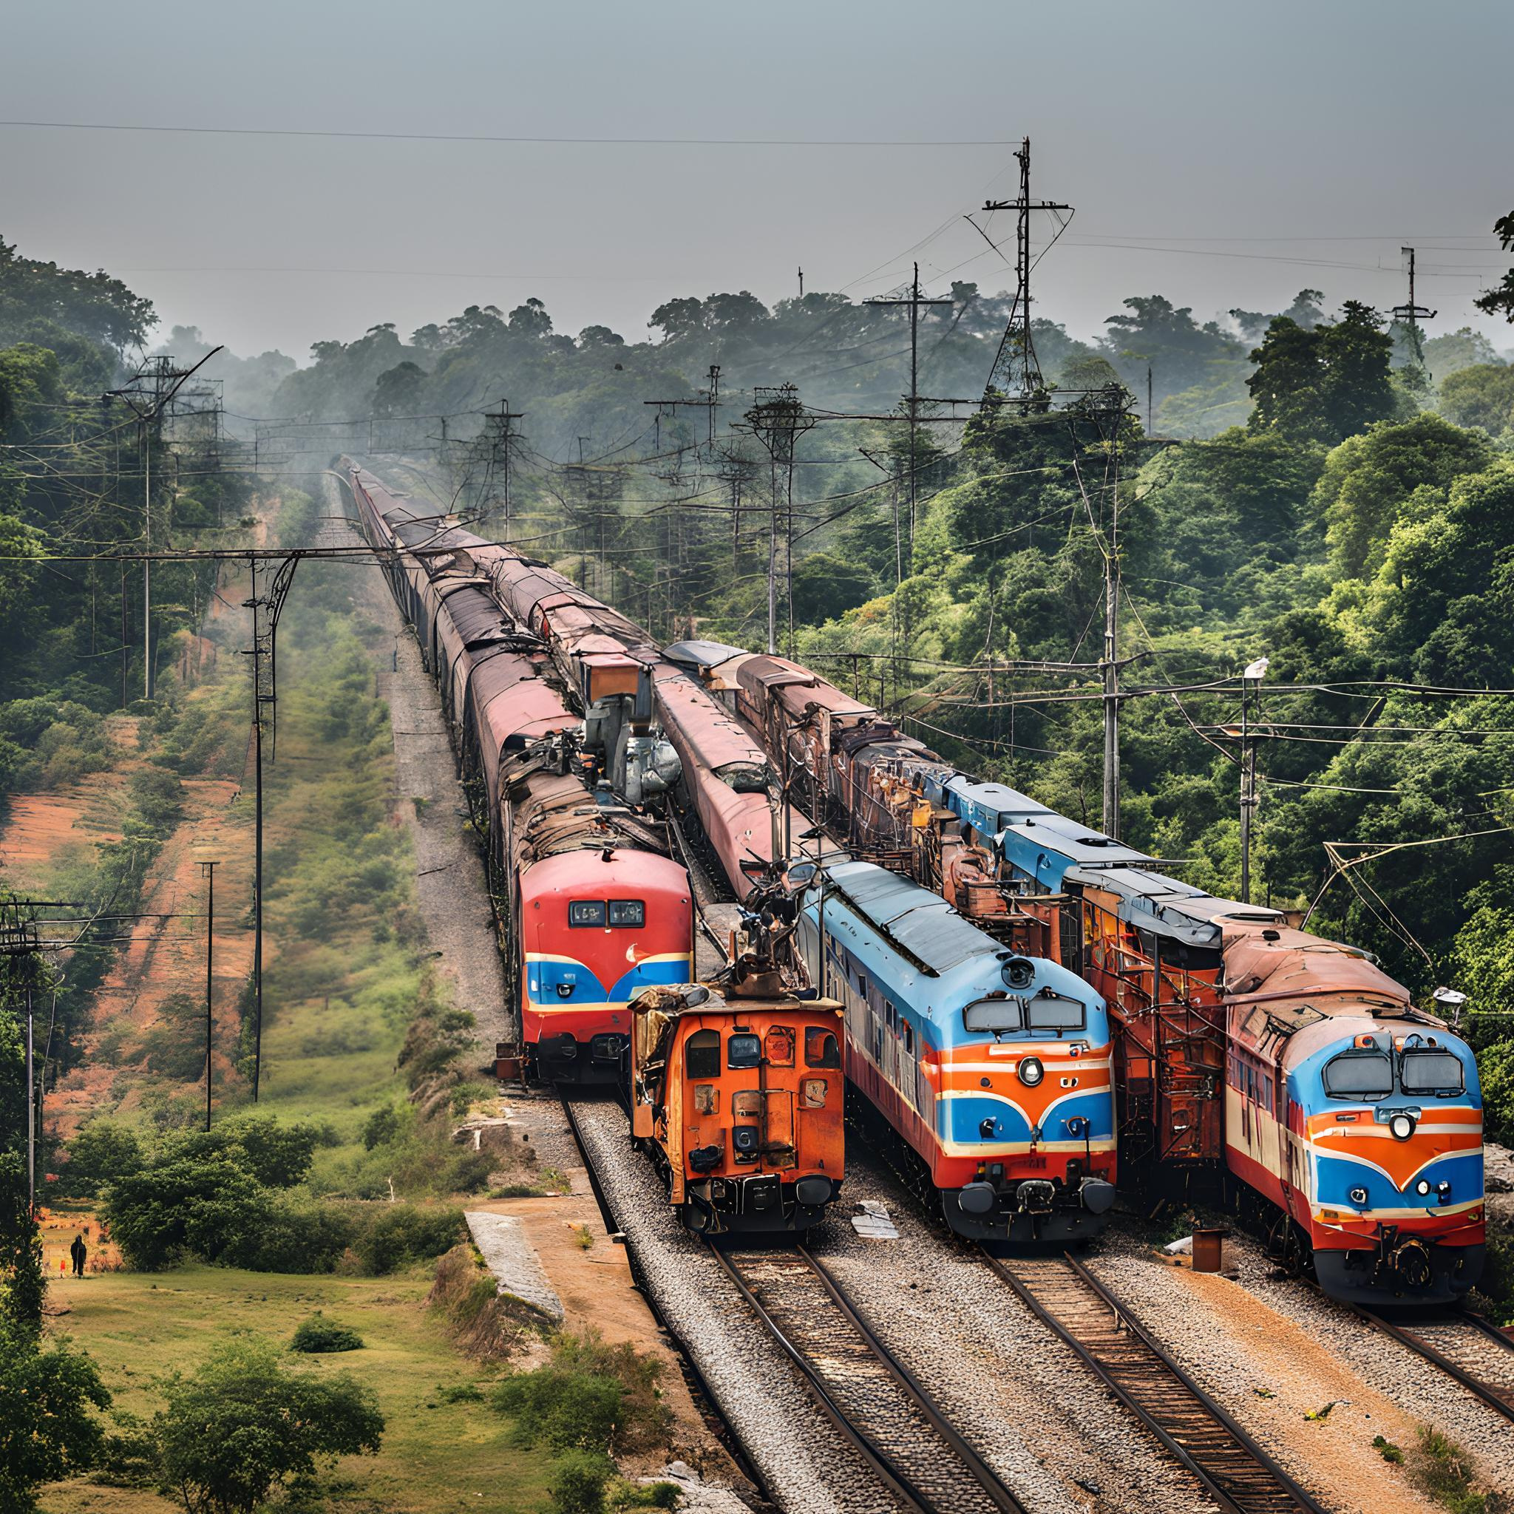
METHEDOLOGY
Data Collection
Collect high-resolution satellite imagery of railway infrastructure (tracks, bridges, tunnels, etc.) from sources like Google Earth, Sentinel, and commercial satellites.
Preprocessing
reprocess images by correcting distortions, removing clouds, and georeferencing to ensure data accuracy.
AI Model Development
Develop and train deep learning models (CNN) to detect anomalies such as cracks, structural damage, and vegetation growth.
Integration of Multi-Modal Data
Combine satellite images with additional data (weather, historical incidents) for more accurate risk predictions.
Automated Reporting & Visualization
Real-Time Monitoring
Deploy the AI system for continuous monitoring, triggering alerts for timely maintenance actions.
Evaluation & Optimization
Regularly evaluate AI performance against manual inspections, refining models for improved accuracy

Slide 4

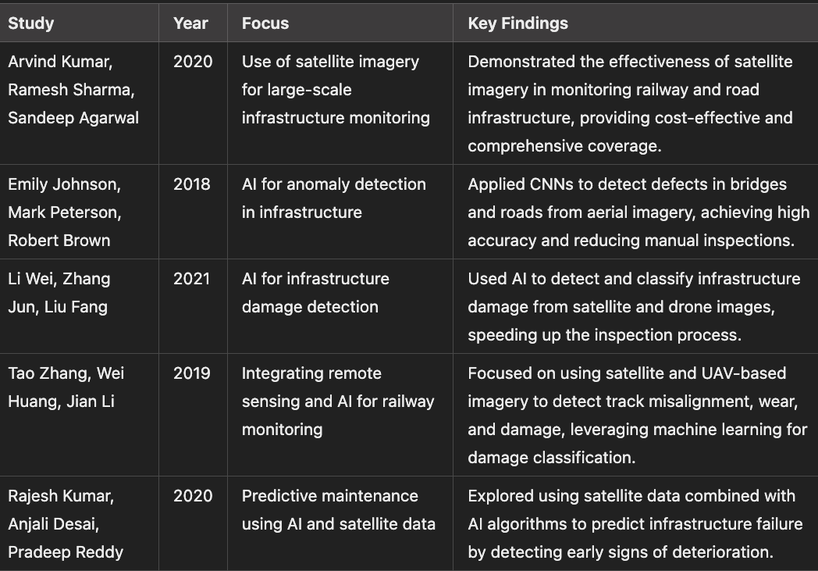
LITERATURE SURVEY

Slide 5
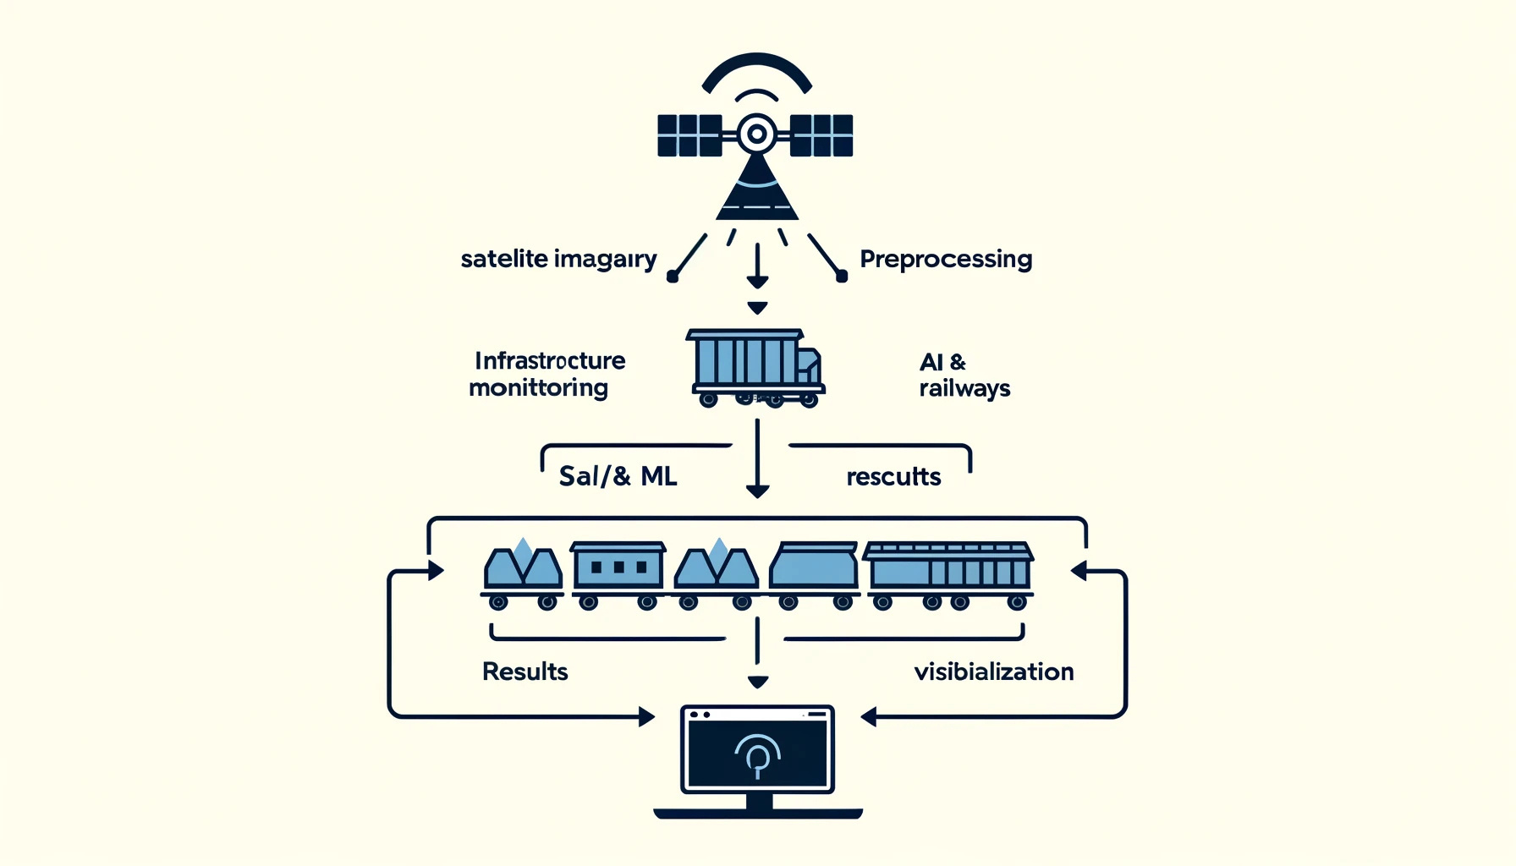
Your paragraph text

Slide 6
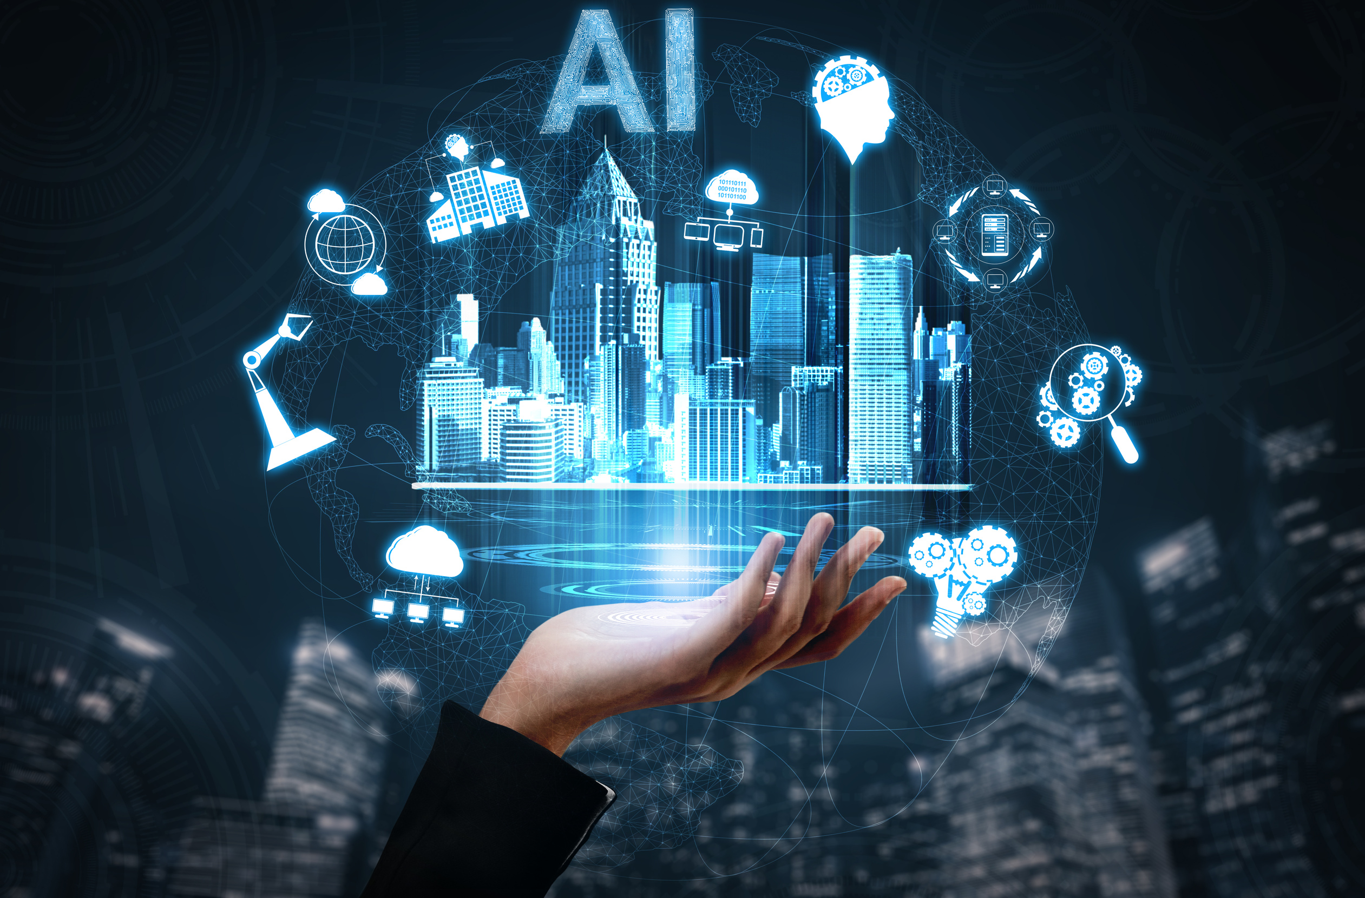
Role of AI in Railway Monitoring
Artificial Intelligence Capabilities:
Analyzing vast datasets from satellite imagery.
Predicting maintenance requirements and disruptions.
Enhancing decision-making for train schedules and operations.
Machine Learning Applications:
Forecasting track wear-and-tear.
Optimizing logistics for punctuality.

Slide 7
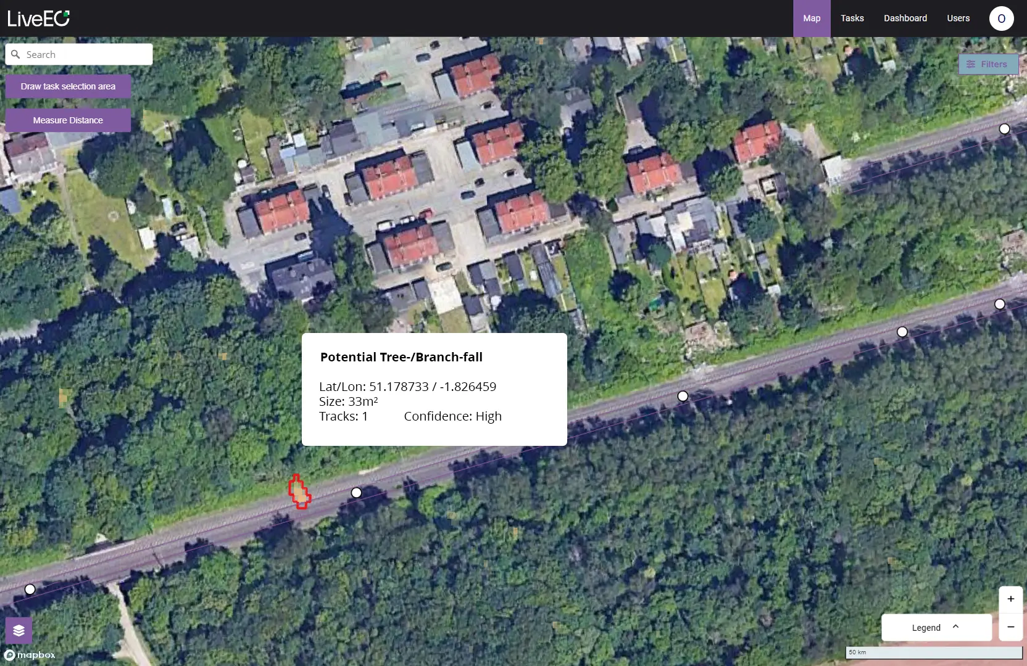
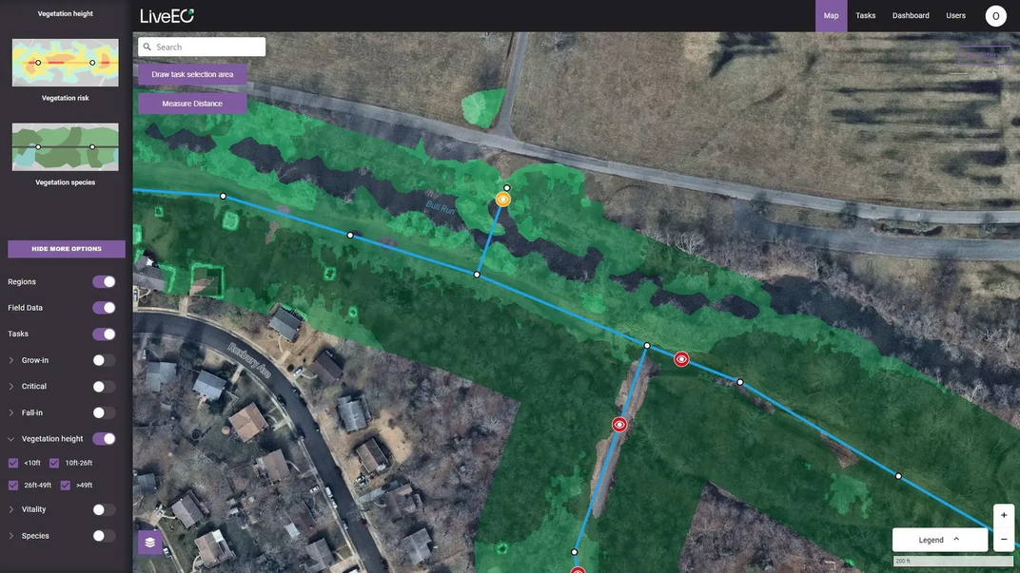
OUTPUT

Slide 8
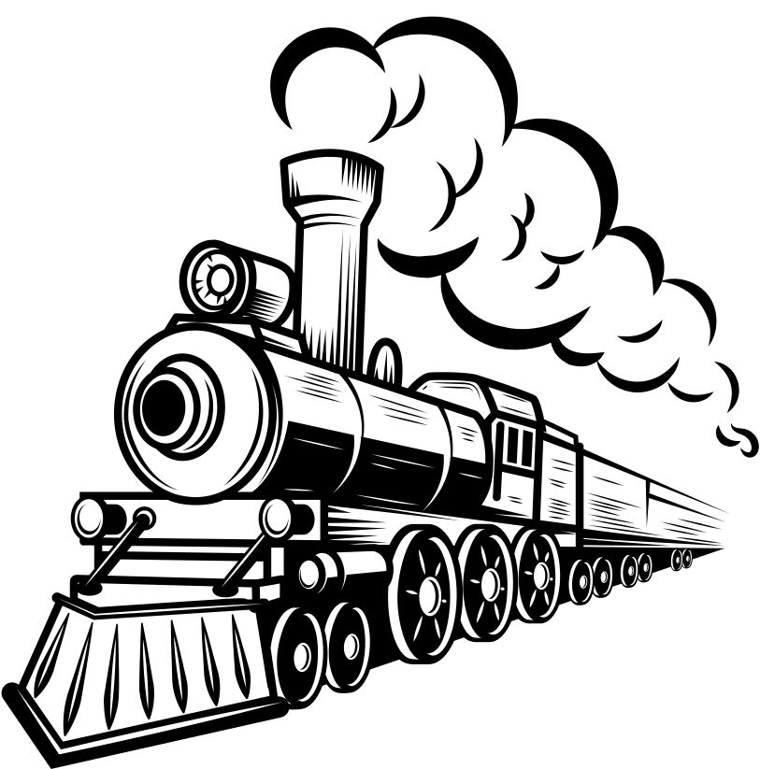
Thank You!

